Slide 1
IoT and open-source
in commercial solutions
Milan Savić, Software Architect

Slide 2
Content
Importance of open-source in IoT
Development - Open source - Product relation
Linux as a cornerstone in IoT
Execom IoT
Using open-source for marketing purposes
Popular IoT concepts
Execom smart city showcase
Making smart city concept open-source

Slide 3
Importance of open-source in IoT
What is IoT?
Increase in number of connected devices
IoT is a fast-changing field
What does that mean for us?
Adapt development process in order to keep pace with the technology

Slide 4
Development - Open source - Product
Open-source is present in (almost) every solution
OS
Frameworks
Libraries
Hardware

Slide 5
Development - Open source - Product
Requirements when developing a commercial solution
Minimize cost of development
Tight deadlines
Always have a working demo
How open-source helps

Slide 6
Development - Open source - Product
Example - Add speech recognition to your IoT solution
Should I use a mobile device?
Hardware
OS
Speech recognition engine
Framework

Slide 7
Linux as a cornerstone in IoT
Widespread OS in IoT products
Security issues on small embedded IoT devices and how to solve that
One IoT device to rule them all
IoT gateway

Slide 8
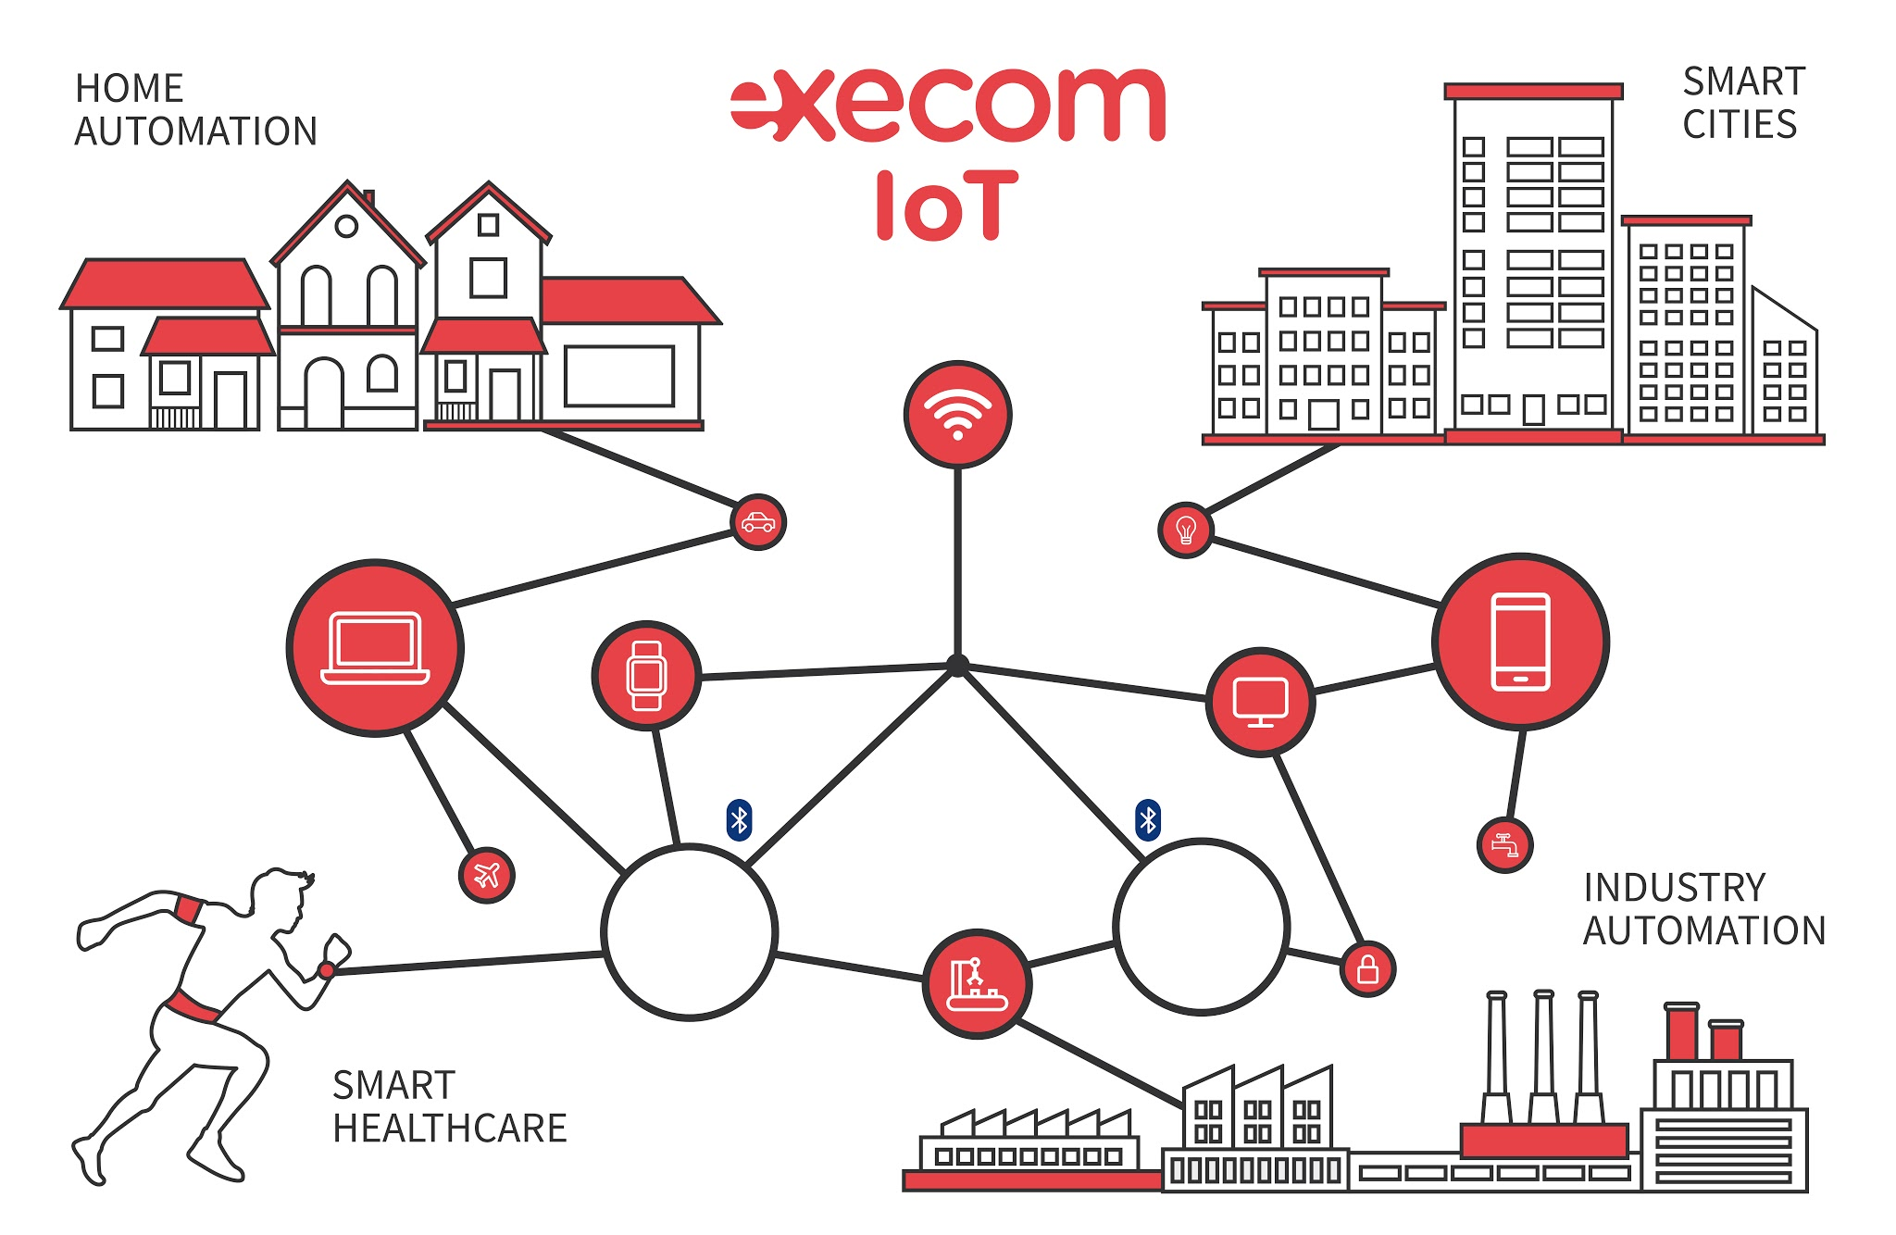

Slide 9
Execom IoT
Requirements:
Modular
Adaptable
Reduces development time
Sensor hub concept

Slide 10
Execom IoT
Notes:
Delovi demo-a
Rpi i zasto smo se odlucili za Rpi (idealna platforma za development)
Hexiwear
Sensor Hub

Slide 11
Execom IoT
What have we learned from sensor hub development
Absolute need to be cross-platform
Why should I use a framework?
Poco framework
Poco or Boost
Notes:
Start projekta je najvazniji

Slide 12
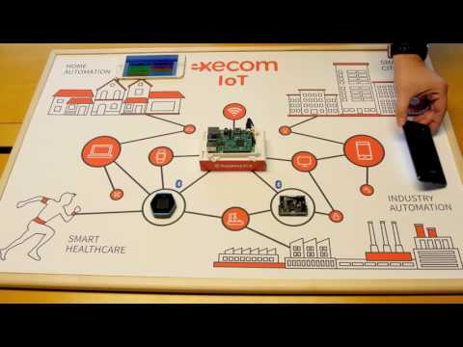
Execom IoT
Sensor hub demo

Slide 13
Using open-source for marketing purposes
Gain community and make a hype by making part of your code public
What are the pitfalls when doing so?
Exposing too much
Open-sourced code is not very useful
WolkAbout IoT platform

Slide 14
Popular IoT concepts
IoT as a part of a bigger picture
Popular IoT concepts:
Home Automation
Smart City
Why is a Smart City interesting concept for Serbia
Lack of good ideas
Macchina.io IoT framework

Slide 15
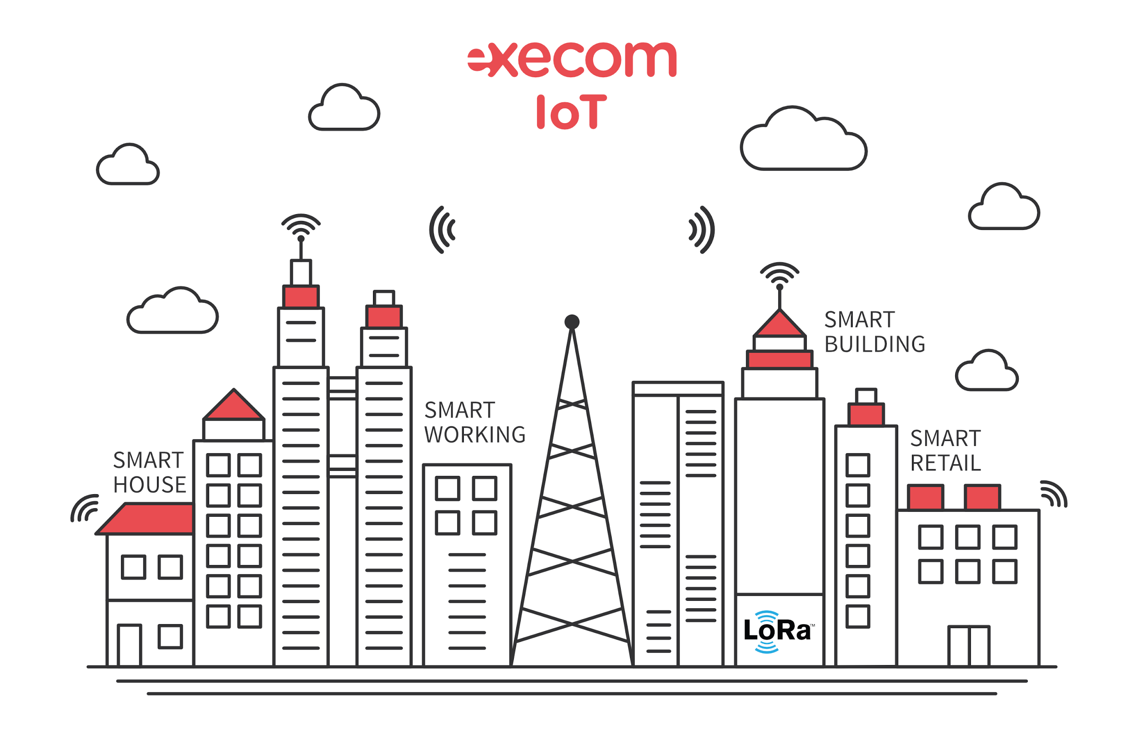
Execom Smart City

Slide 16
Execom Smart City
Hardware
Arduino
Raspberry Pi
LoRa protocol
How open-source helped to develop this showcase

Slide 17
Execom Smart City

Slide 18
Making Smart City open-source
Smart City showcase is open-source
Android app
LoRa receiver
Data gathering
Cloud connection
LoRa sensor
It’s not much, but it’s a start :)
Notes:
Jos jedan slajd dodati ukoliko uspemo sve da stavimo na njihov github na vreme i tu proci kroz uputstvo kako izbildovati sve

Slide 19

GDG Novi Sad
Android App
bit.ly/gdgns-aa
Facebook
bit.ly/gdgns-fb
iOS App
bit.ly/gdgns-ios
Google Plus
bit.ly/gdgns-gp
Meetup.com
bit.ly/gdgns
Twitter
bit.ly/gdgns-tw

Slide 20


Join our team!
careers@execom.eu www.execom.eu

